Slide 1
World population analysis
Presented by: Fahd Ashraf
Last Updated: September 29th, 2022

Slide 2
Table of contents
World population
Population Variation from (1970 – 2022)
Conclusion

Slide 3
What are we talking about ?

Slide 4
Objective
Observe the population growth across all countries and continents during the time period from 1970 to 2022

Slide 5
Data Visualization

Slide 6
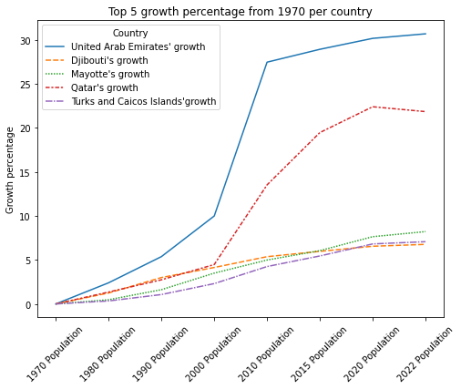
Population Growth per Country
UAE and Qatar have the most population growth from 1970 with 3000% and 2100% respectively
UAE growed from 300,000 citizen to 9.4M citizen
Qatar growed from 118,000 citizen to 2.6M citizen

Slide 7
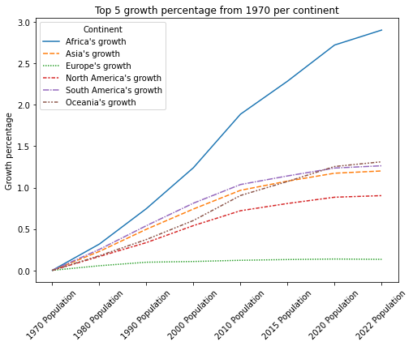
Population Growth per Continent
Africa’s growth nearly reaches 300 times the population in 1970
Oceania’s growth passed South America in the past decade
Europe’s growth is nearly at zero

Slide 8
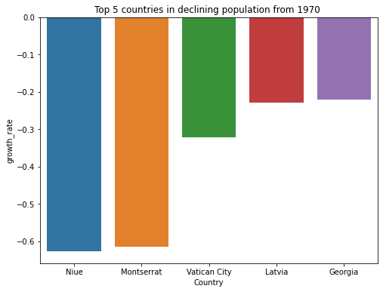
Population reduction per Country
Niue and Montserrat have lost over 50% of their population in the time period addressed
Most of the countries that losses population is in Europe

Slide 9
Conclusion

Slide 10
Conclusion
Africa is the leading continent in the field of population growth
Europe’s population growth is nearly zero for the past 50 years
UAE and Qatar have the highest population growth per country
Niue and Montserrat have the most population reduction for the past 50 years

Slide 11
Thank you

